Slide 1
A Parameterized Type System for Race-Free Java Programs
Paper by Boyapti & Rinard, 2001
Christopher Dentel
ETH, Concepts of Concurrent Computation, 2012
Notes:
Introduce, say background

Slide 2
Concurrent “Gold Standard”
Expressive, flexible system
Data races are impossible
Reduce unnecessary lock acquisitions

Slide 3
Parameterized Race Free Java (PRFJ)
Based on Concurrent Java
Static type system for multithreaded Java
Guarantees all well-typed systems are race free
Classes have “generic” locking implementation
Different instances can have different lock synchronization behavior
Minimal programming overhead

Slide 4
How does PRFJ accomplish this?
Goal: Race-Free Programs
Objects must be “owned” by
Themselves,
Other objects, OR
Thread (local to thread)
Ownership does not change
Ownership declared as first generic parameter

Slide 5
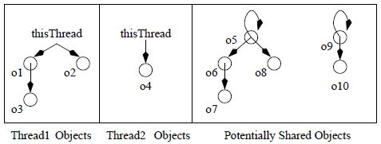
Consequences of Ownership
“Forest of rooted trees, where the roots can have self loops”
Necessary and sufficient for object to hold root lock
Thread implicitly holds lock on objects it owns

Slide 6
PRFJ Accounts
class Account<thisOwner> {
int balance = 0;
int deposit(int x) requires (this) {
this.balance = this.balance + x;
}
}
Account<thisThread> a1 = new Account<thisThread>;
a1.deposit(10);
Account<self> a2 = new Account<self>;
fork(a2) {synchronized (a2) in { a2.deposit(10)}};
fork(a2) {synchronized (a2) in { a2.deposit(10)}};
Notes:
In PRFJ methods can require the caller to hold the lock on the object (the objects root). Every caller must satisfy this. Synchronized requests the lock for a2.

Slide 7
Unique ownership mechanism
Unique: only one pointer at a time
If only one pointer exists, then no need for locks
Producer consumer design pattern
Can “hand off” object to another thread or safely pass
Accomplished through 2 mechanisms
Pointer surrendering
Sharing pointer with “non escaping” methods

Slide 8
Pointer Surrendering
Surrender pointer using ‘*--‘ syntax
Queue<self, T<unique>> q =
new Queue<self, T<unique>>();
T<unique> t1 = new T<unique>;
T<unique> t2 = new T<unique>;
synchronized (q) in {q.offer( t1-- );}
synchronized (q) in {q.offer( t2-- );}
fork(q) {synchronized(q) in {T<unique> t=q.poll();}}
fork(q) {synchronized(q) in {T<unique> t=q.poll();}}
Notes:
SHIFT OVER

Slide 9
Sharing pointer with “non escaping” methods
Keep object in the same thread
Methods denote this by appending ‘!e’ to the type
class Message<thisOwner> {…}
class Util<thisOwner, MsgOwner> {
void display(Message<MsgOwner !e m) requires(m){…}
}
Util<self, unique> u = new Util<self, unique>;
Message<unique> m = new Message<unique>
u.display(m);

Slide 10
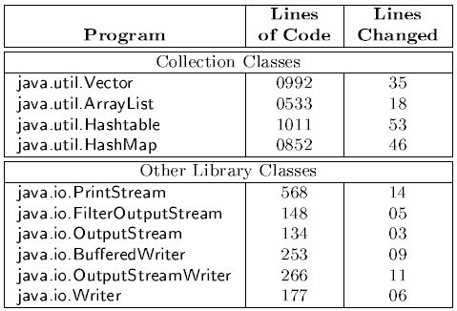
Implementation Overhead

Slide 11
Runtime Overhead
Statically Typed
Ownership relations only checked at compile time
PRFJ can be compiled to Concurrent Java
But further optimizations can be made
Heap-space allocation

Slide 12
Limitations and Criticisms
Runtime Casts
No way to check ownership at runtime
Static Variables
Must hold lock for class

Slide 13
Parameterized Race Free Java
Flexible
Generic protection mechanisms
Efficient
Runtime
Implementation
Avoids unnecessary locks

Slide 15
Default Types
Single-Threaded Program
Ownership of class constrained to thisThread
Any unparameterized instance variables owned by thisThread
Any unparameterized methods have empty requires clause
Multithreaded Programs
Ownership of class constrained to thisOwner
Unparamaterized instance variables owned by thisOwner
Unparamterized methods require this and all arguments

Slide 16
Self Synchronization
class SharedAccount<self> extends Account<self> {
(@Override)
int deposit(int x) requires () {
syncrhonized(this) in {super.deposit(x);}
}
}
SharedAccount<self> a = new SharedAccount<self>;
fork(a) {a.deposit(10)};
fork(a) {a.deposit(10)};
Constant value used instead of a formal parameter

