Slide 1
Einführung in die Programmierung Introduction to Programming Prof. Dr. Bertrand Meyer
Exercise Session 10

Slide 2
Today
Multiple inheritance

Slide 3
Combining abstractions
Given the classes
TRAIN_CAR, RESTAURANT
how would you implement a DINER?
Notes:
Multiple inheritance is the easy guess, but depending on the circumstances the solution can be fragile, because it is sensitive to changes in the ancestors that can affect the semantics of the descendant in an unpredictable way

Slide 4
Inheritance is never the only way
Given the classes
TRAIN_CAR, RESTAURANT
how would you implement a DINER?
You could have an attribute in TRAIN_CAR
train_service: SERVICE
Then have RESTAURANT inherit from SERVICE
This is flexible if the kind of service may change to a type that is unrelated to TRAIN_CAR
Changes in TRAIN_CAR do not affect SERVICE easily

Slide 5
Examples of multiple inheritance
Hands-On
Combining separate abstractions:
Restaurant, train car
Calculator, watch
Other examples?

Slide 6
Examples of multiple inheritance
Hands-On
Combining separate abstractions:
Restaurant, train car
Calculator, watch
Other examples?
Teacher, student
Home, vehicle

Slide 7
Multiple inheritance: Combining abstractions
<, <=, >, >=, …
+, –, ∗, / …
COMPARABLE
NUMERIC
(total order relation)
(commutative ring)
INTEGER
REAL
STRING
COMPLEX

Slide 8
Composite figures

Slide 9
Multiple inheritance: Composite figures
Simple figures
A composite figure

Slide 10
Defining the notion of composite figure
center
display
hide
rotate
move
…
V_LIST [FIGURE ]
FIGURE
count
put
remove
…
COMPOSITE_FIGURE

Slide 11
In the overall structure
V_LIST [FIGURE ]
FIGURE
OPEN_ FIGURE
CLOSED_ FIGURE
perimeter*
COMPOSITE_FIGURE
SEGMENT
POLYLINE
POLYGON
ELLIPSE
perimeter⁺
perimeter⁺
diagonal
RECTANGLE
CIRCLE
TRIANGLE
perimeter⁺⁺
perimeter⁺⁺
SQUARE
perimeter⁺⁺
Notes:
11

Slide 12
A composite figure as a list
before
after
item
forth
Cursor

Slide 13
Composite figures
class COMPOSITE_FIGURE inherit
FIGURE
V_LIST [FIGURE]
feature
display
-- Display each constituent figure in turn. do from start until after loop
item.display
forth end end
... Similarly for move, rotate etc. ...
end
Requires dynamic binding

Slide 14
An alternative solution: the composite pattern
LIST [FIGURE ]
FIGURE
figure_list
OPEN_ FIGURE
CLOSED_ FIGURE
perimeter*
COMPOSITE_FIGURE
SEGMENT
POLYLINE
POLYGON
ELLIPSE
perimeter⁺
perimeter⁺
diagonal
RECTANGLE
CIRCLE
TRIANGLE
perimeter⁺⁺
perimeter⁺⁺
SQUARE
perimeter⁺⁺
Notes:
14

Slide 15
The Java-C# solution
No multiple inheritance for classes
“Interfaces”: specification only (but no contracts)
Similar to completely deferred classes (with no effective feature)
A class may inherit from:
At most one class
Any number of interfaces

Slide 16
Lessons from this example
Typical example of program with holes
We need the full spectrum from fully abstract (fully deferred) to fully implemented classes
Multiple inheritance is there to help us combine abstractions

Slide 17
Multiple inheritance: Name clashes
Hands-On
A
B
f
f
C
?

Slide 18
Resolving name clashes
Hands-On
A
B
f
f
rename f as A_f
C
A_f, f

Slide 19
Consequences of renaming
Hands-On
Valid or invalid?
a1 : A
b1 : B
c1 : C
...
c1.f
a1.A_f
c1.A_f
b1.f
b1.A_f
f
A
B
f
rename f as A_f
Valid
C
A_f, f
Invalid
Valid
Valid
Invalid

Slide 20
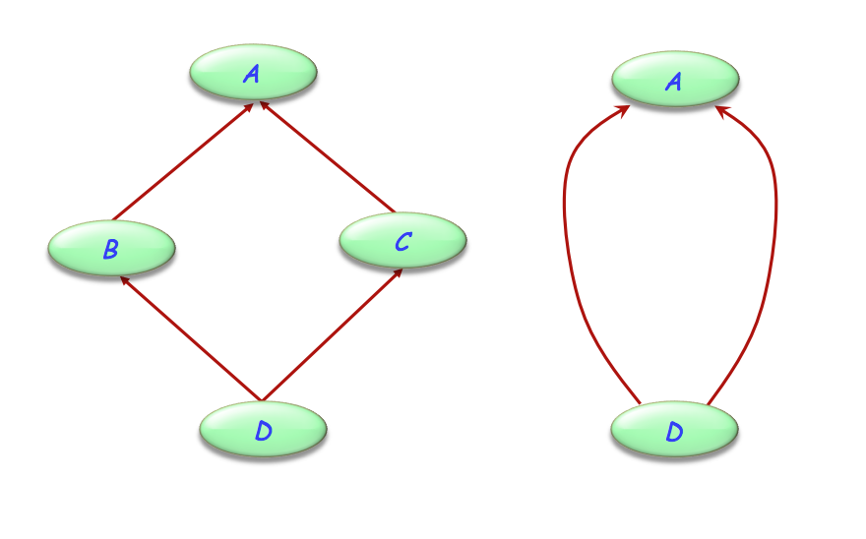
Are all name clashes bad?
A name clash must be removed unless it is:
Under repeated inheritance (i.e. not a real clash)
Between features of which at most one is effective (i.e. others are deferred)
indirect repeated inheritance
direct repeated inheritance

Slide 21
Feature merging
f *
A
f *
B
C
f ⁺
D
∗ Deferred
⁺ Effective

Slide 22
Feature merging: with different names
class
D
inherit
A rename
g as f
end
B
C rename
h as f
end
feature
...
end
A
g *
B
f *
C
h ⁺
g
f
h
f
D
∗ Deferred
⁺ Effective
Renaming

Slide 23
Feature merging: effective features
f ⁺
A
f ⁺
B
C
f ⁺
f ⁻⁻
f ⁻⁻
D
∗ Deferred
⁺ Effective
⁻⁻ Undefine

Slide 24
Undefinition
deferred class
T
inherit
S
undefine v end
feature
...
end

Slide 25
Merging through undefinition
f ⁺
A
f ⁺
B
C
f ⁺
class
D
inherit
A undefine f end
B
C undefine f end
feature
...
end
f ⁻⁻
f ⁻⁻
D
∗ Deferred
⁺ Effective
⁻⁻ Undefine

Slide 26
Merging effective features with different names
f ⁺
A
g ⁺
B
h ⁺
C
class
D
inherit
A
undefine f end
B
rename
g as f
undefine f
end
C
rename
h as f
end
feature ... end
g
f
f ⁻⁻
f ⁻⁻
h
f
D
Notes:
26

Slide 27
Acceptable name clashes
If inherited features have all the same names, there is no harmful name clash if:
They all have compatible signatures
At most one of them is effective
Semantics of such a case:
Merge all features into one
If there is an effective feature, it imposes its implementation
Notes:
27

Slide 28
Feature merging: effective features
a1: A b1: B c1: C d1: D
a1.g b1.f c1.h d1.f
g+
A
f+
B
h+
C
g f
h f
D
f-
f-

Slide 29
Exercise: All-in-one-device
Hands-On
PRINTER
SCANNER
FAX
ALL_IN_ONE_DEVICE

Slide 30
Exercise: All-in-one-device
Hands-On
class PRINTER
feature
print_page -- Print a page.
do
print ("Printer prints a page...")
end
switch_on -- Switch from ‘off‘ to ‘on‘
do
print ("Printer switched on...")
end
end
class FAX
feature
send -- Send a page over the phone net.
do
print (“Fax sends a page...")
end
start -- Switch from ‘off‘ to ‘on‘
do
print (“Fax switched on...")
end
end
class SCANNER
feature
scan_page -- Scan a page.
do
print (“Scanner scans a page...")
end
switch_on -- Switch from ‘off‘ to ‘on‘
do
print (“Scanner switched on...")
end
send -- Send data to PC.
do
print (“Scanner sends data...")
end
end

Slide 31
Exercise: All-in-one-device
Hands-On
PRINTER
SCANNER
FAX
ALL_IN_ONE_DEVICE
class
ALL_IN_ONE_DEVICE
inherit
...
end
How to resolve the name clashes?
switch_on
send
Notes:
Merge switch_on/switch_on/start, as they denote the same concept. Don‘t merge send/send, as they denote different concepts.

Slide 32
Exercise: All-in-one-device
Hands-On
class ALL_IN_ONE_DEVICE
inherit
PRINTER
rename
switch_on as start
undefine
start
end
SCANNER
rename
switch_on as start,
send as send_data
end
FAX
rename
send as send_message
undefine
start
end
feature ... end

Slide 33
Valid or invalid?
Hands-On
class ALL_IN_ONE_DEVICE
inherit
PRINTER
rename
switch_on as start
undefine
start
end
SCANNER
rename
switch_on as start,
send as send_data
end
FAX
rename
send as send_message
undefine
start
end
feature ... end
s: SCANNER
f: FAX
a: ALL_IN_ONE_DEVICE
a.switch_on
a.print_page
f.send_message
s.switch_on
f.send
a.send
Invalid
Valid
Invalid
Valid
Valid
Invalid

Slide 34
A special case of multiple inheritance
UNIVERSITY_MEMBER
id
TEACHER
STUDENT
??
??
ASSISTANT
????
This is a case of repeated inheritance

Slide 35
Indirect and direct repeated inheritance
A
A
B
C
D
D
Notes:
Direct repeated inheritance makes sense if you want to redefine features from the ancestor while keeping the ancestor versions.

Slide 36
Multiple is also repeated inheritance
A typical case:
ANY
copy
is_equal
copy ⁺⁺
is_equal ⁺⁺
LIST
C
copy C_copy
D
is_equal C_is_equal
??

Slide 37
Sharing and replication
f
g
A
g g_b
g g_c
B
C
D
Features such as f, not renamed along any of the inheritance paths, will be shared.
Features such as g, inherited under different names, will be replicated.

Slide 38
The need for select
copy
is_equal
ANY
LIST
C
copy ⁺⁺
is_equal ⁺⁺
copy C_copy
is_equal C_is_equal
D
A potential ambiguity arises because of polymorphism and dynamic binding:
a1 : ANY
d1 : D
…
a1 := d1 a1.copy (…)
Notes:
38

Slide 39
Removing the ambiguity
class
D
inherit V_LIST [T ]
select
copy,
is_equal
end
C rename copy as C_copy,
is_equal as C_is_equal,
... end
Notes:
39

Slide 40
When is a name clash acceptable?
(Between n features of a class, all with the same name, immediate or inherited.)
They must all have compatible signatures.
If more than one is effective, they must all come from a common ancestor feature under repeated inheritance.

